Slide 1

HUMAN RESOURCES
INTERNATIONAL
M&A INTEGRATION

Slide 2

Agenda
Meeting Objectives
Communication Restrictions – EMEA
Translation Process
Distribution Process - EMEA & AP
Distribution Process – AP
Communication/Translation Process
HR Recommendations - Organization Structure
HR Recommendations - Processes
© 100-Day Advisors MandAPlaybook.com

Slide 3

Meeting
Objectives
Communication
To integrate EMEA into the Acquirer’s communication process
To identify translation needs and define process
Clarify implementation communication expectations and deliverables for January through March.
Human Resources
Recommend an HR organization structure for EMEA
Identify synergies among HR processes
© 100-Day Advisors MandAPlaybook.com

Slide 4
Communication Restrictions - EMEA
1.
We must take additional precautions for confidentiality when communicating in EMEA and about EMEA in other regions.
2.
This is because we must communicate first with the works council for their opinion on our proposals. Specifically, the works council must provide an opinion on:
All organizational structure changes (e.g. plant closings, moving work from one location to another, etc.).
Impact on headcount (organization charts restructure, reductions)
3.
Our communications, (all documents), should not mention that any “decision” has been made that impacts EMEA. All plans should be communicated as proposals to avoid legal action of works council and trade unions.
In this type of action, the responsibility of the company, but also of the personal responsibility of managers can be implied.
4.
Please ask the implementation communication/Human Resources leader to review all communications regarding the integration/implementation.
© 100-Day Advisors MandAPlaybook.com

Slide 5
Approved Announcement Received by Mgr. Internal Communication (Acquirer EMEA)/HR China (Acquirer AP)
Determine need to translate
Translated by agency
Translation Process
Validation by
Acquirer staff
Returned to Mgr. Internal Communication (Acquirer EMEA)/HR China (Acquirer AP)
Notification of distribution received
© 100-Day Advisors MandAPlaybook.com

Slide 6
Distribution Process - EMEA & AP (before transition period)
Mgr. Internal Communication - EMEA
Human Resources
EMEA
Marketing & Sales
EMEA
Purchasing
EMEA
Internal & External
Asia Pacific
Managers
Customers
Suppliers
China
Asia Pacific
Employees
Press
© 100-Day Advisors MandAPlaybook.com

Slide 7
Distribution Process – AP (after transition period)
Mgr. Internal Communication
Acquirer China
Acquirer China
Asia Pacific
HR
Mktg & Sales
Managers
Managers
Employees
Managers
Suppliers
Employees
Suppliers
Employees
Customers
Suppliers
Customers
Press
Customers
Press
Press
© 100-Day Advisors MandAPlaybook.com

Slide 8
Communication/
Translation Process
1.
The communication process assumes that Communications received from Acquirer corporate or Acquirer leadership are approved and finalized (EMEA, AP, Americas)
2.
Translations will be done if the communication is:
meant for non-management employees
a non-financial press release
meant for Acquirer dealers and/or customers
an update on transition process, organization announcements, etc.
© 100-Day Advisors MandAPlaybook.com

Slide 9
Communication/
Translation Process
3.
Translations will not be done if the communication is:
meant for management level employees only
of interest to management level employees only
a financial press release
except communications on the quarter results (turnover, margin, operating profit) translated for French employees who have invested in the company mutual funds including Acquirer’s shares. These are partial translations of the results only.
4.
Translated languages include:
Internal employees: French, German, Italian, Portuguese, Chinese
Customers/Suppliers/Press: also include Spanish
© 100-Day Advisors MandAPlaybook.com

Slide 10
Communication/
Translation Process
5.
Finalized communications must be submitted 2-3 days in advance of release in order to be translated
Communications should be released on the same day in Americas and EMEA in order to avoid a lag in information.
6.
Translations will be done in EMEA and AP (for Chinese only) due to lower costs
7.
Native speaking/fluent employees will be identified to validate translations
8.
Finalized communication should be sent to the manager of internal communication – Acquirer EMEA for translation and distribution (EMEA/AP)
9.
Budgets for translations need to be established
© 100-Day Advisors MandAPlaybook.com

Slide 11

HR Recommendations - Organization Structure
1.
Current HR Organization
Separate by business
2.
Propose EMEA HR organization structure
Establish an HR organization for EMEA and organize local HR by country (different laws)
Establish a Director of HR for EMEA who will have a direct reporting relationship to the EVP EMEA and a dotted line report to the SR. VP of HR
A new position of Resource Development EMEA has been created
  This position is responsible for performance management, succession planning, data collection, expat. program, and internal communications (1 direct report for comm.)
France and Germany will continue to run full HR organizations. Their org charts remain similar.
In Italy, Portugal and the UK controllers will be responsible for HR
A net headcount reduction of 5 has been identified for EMEA
© 100-Day Advisors MandAPlaybook.com

Slide 12

HR Recommendations - Processes
1.
Recruiting Process
All requisitions for new positions must be approved by EVP EMEA
All recruiting for Manager level and below will be done at the local plant site
All Director level and above (executive recruiting) for EMEA will be conducted by the HR EMEA Director and the Resource Development manager
  these positions are approved by EVP EMEA
2.
As an Effective International Employer, we must have an "Employee Relocation Plan "
We anticipate that the transition planning will identify "Key Employees " who will need to relocate.
Relocation policy should cover
  Internal relocation within National boundaries
  External relocation outside of National and or continental boundaries
© 100-Day Advisors MandAPlaybook.com

Slide 13
HR Recommendations - Processes
3.
Recommend that EMEA participate in the Acquirer Corporate performance management and succession planning system for 2025 to the extent participation does not interfere with data privacy
4.
EMEA will use ADP as the payroll processing system. However, the payrolls will be separated by country due to tax laws
France payroll will migrate into Acquiree’s payroll system
German will migrate to the Acquirer’s Payroll.
The UK and Portugal may remain on its own system due to its small size
Italy will continue to outsource its payroll
5.
PeopleSoft HRIS strategy will be a corporate initiative and is out of scope for the EMEA integration team
© 100-Day Advisors MandAPlaybook.com

Slide 14
HR Recommendations - Processes
6.
A European Works council must be established by in the next two years. Negotiations for the implementation must start by April 2025
  A European works council agreement has already been signed in Germany. This agreement has never been applied but is still valid. It will be taken into consideration for future negotiations
7.
Recommend consultant assistance to advise on Works Council procedures and implementation of workforce reduction strategy for Germany, France and UK
© 100-Day Advisors MandAPlaybook.com

Slide 15
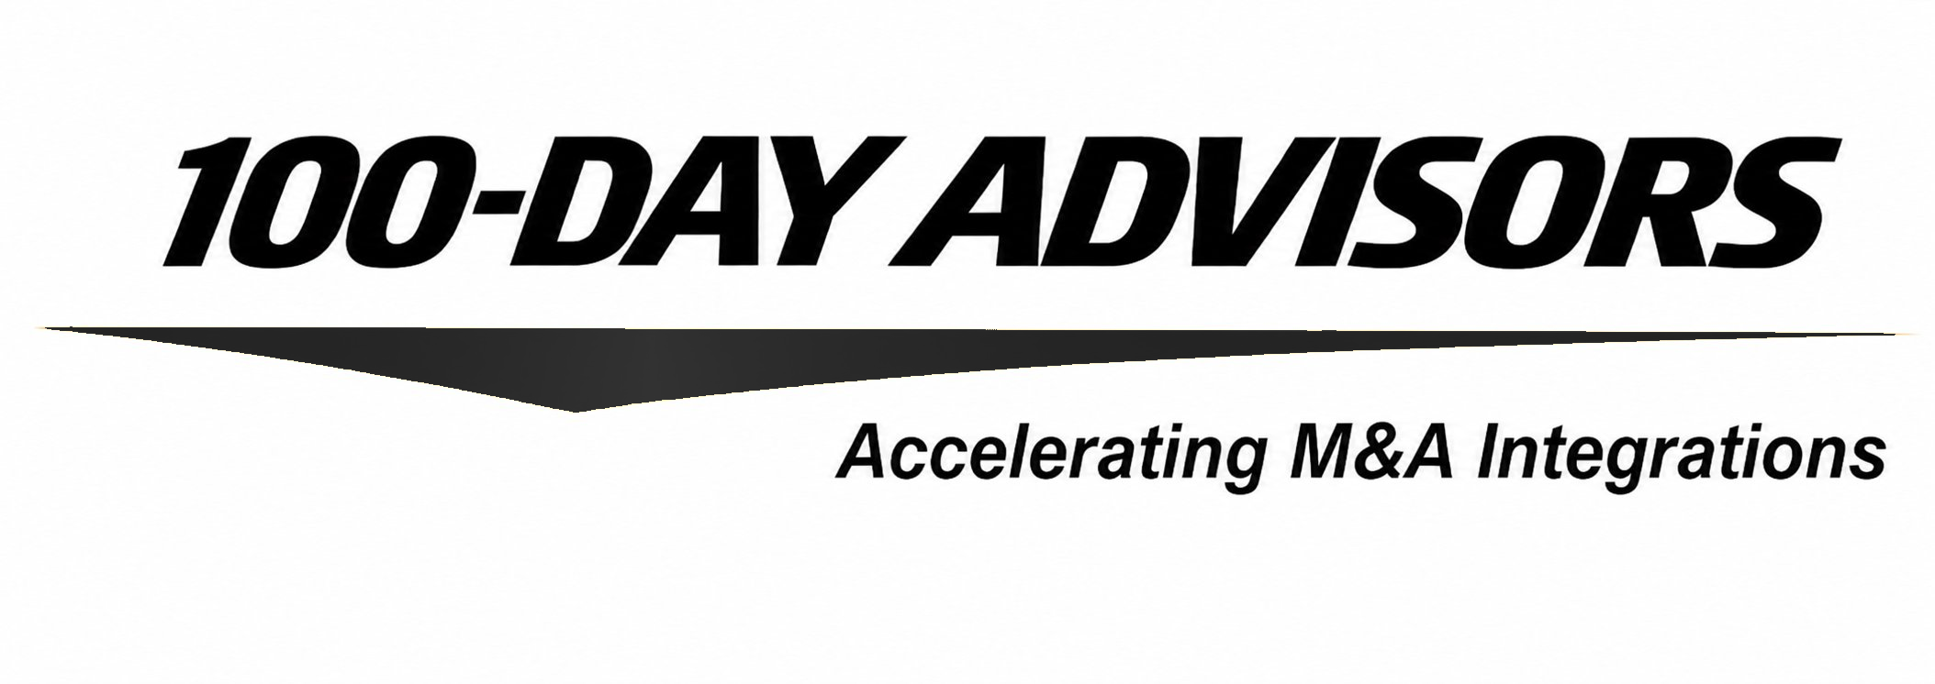


thank you
contact us
email
inquiries@MandAPlaybook.com
website
MandAPlaybook.com/consulting
15

